Slide 1


CWCT 140
Professor David Lieberman
dlieberman@ivytech.edu

Slide 2
Agenda
Generators
List Comprehension
Lambda Expressions
CyberAttacks!
Reading CSV Files
Plot CSV Data
SOAP Services
Consuming a Web Service

Slide 3
Generator
The “range” function is a generator
The “yield statement can create a custom generator
def fun_x2(n):
for i in range(n):
yield i * 2
for v in fun_x2(5):
print(v)
0
2
4
6
8

Slide 4
List Comprehension
List expressions that are compact and elegant
list_1 = []
#Traditional
for ex in range(6):
list_1.append(10 ** ex)
#Using list comprehension
list_2 = [10 ** ex for ex in range(6)]
print("list_1", list_1)
print("list_2", list_2)
list_1 [1, 10, 100, 1000, 10000, 100000]
list_2 [1, 10, 100, 1000, 10000, 100000]

Slide 5
Lambda Expressions
In Python, you can define an anonymous function on the fly, without having to give it a name.
The term lambda comes from lambda calculus, a formal system of mathematical logic for expressing computation based on function abstraction and application.
sumTwo = lambda a, b: a + b
print(sumTwo(5,10))

Slide 6
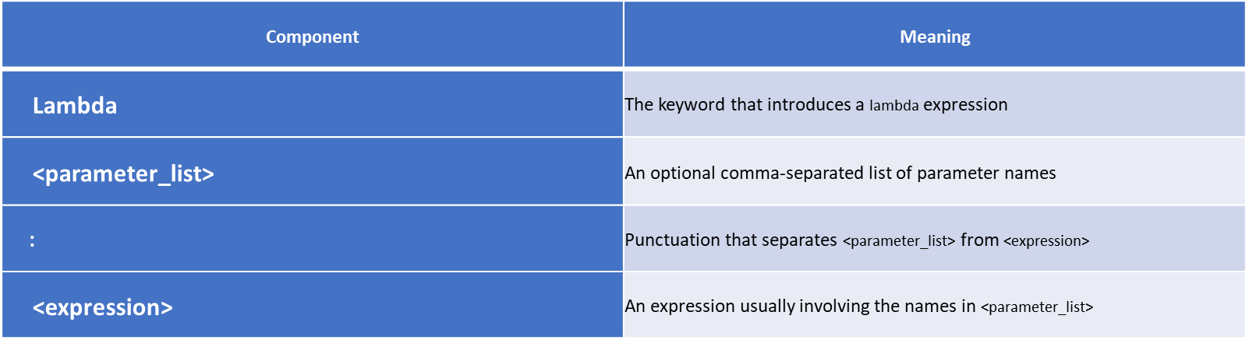
Lambda Expressions
The syntax of a lambda expression is as follows: lambda <parameter_list>: <expression>

Slide 7
Lambda Expressions
Example of non-Lambda code:
def sumTwo(a, b):
result = a+b
return result
print(sumTwo(5,10))
Example Lambda code:
sumTwo = lambda a, b: a + b
print(sumTwo(5,10))

Slide 8
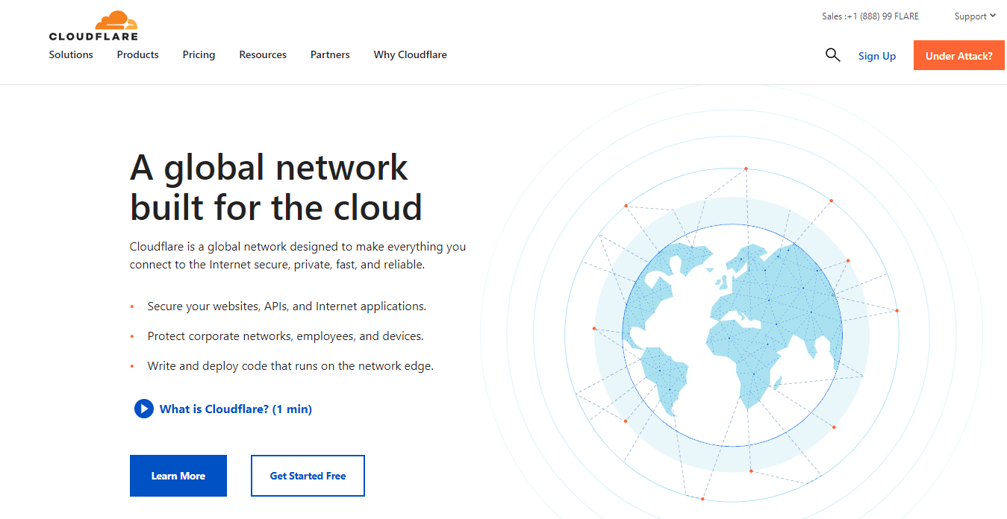
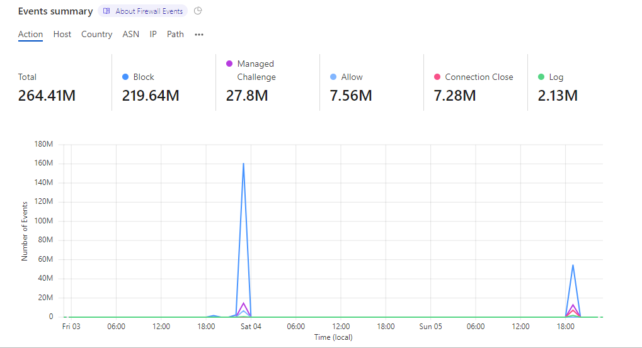
Cyber Attacks

Slide 9

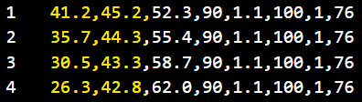
Read CSV Files
CSV is an “Excel” file
Each line (row) contains data separated by “,”
The data in this file was acquired from weight sensors in a treadmill.
Highlighted values are left/right footfalls

Slide 10
Read File Stream
open function creates a filestream “f”
csv.reader returns an iterator for the parsed rows of the CSV file
list(reader) creates a list of the rows
import csv
with open('CWCT140\\Walking_SensorData.csv', newline='') as f:
reader = csv.reader(f)
data = list(reader)
print(data)
[['41.2', '45.2', '52.3', '90', '1.1', '100', '1', '76’],
['35.7', '44.3', '55.4', '90', '1.1', '100', '1', '76’],
['30.5', '43.3', '58.7', '90', '1.1', '100', '1', '76’]]

Slide 11
Extract Data Lists
row[0] contains column 1 data (left foot)
list comprehension iterates through all of the rows
sensor1_list contains list of all left foot data
sensor2_list contains list of all right foot data
sensor1_list = [float(row[0]) for row in data]
sensor2_list = [float(row[1]) for row in data]
print(sensor1_list)
print(sensor2_list)
[41.2, 35.7, 30.5, etc.]
[45.2, 44.3, 43.3, etc.]

Slide 12
Extract Data Lists
row[0] contains column 1 data (left foot)
list comprehension iterates through all of the rows
sensor1_list contains list of all left foot data
sensor2_list contains list of all right foot data
sensor1_list = [float(row[0]) for row in data]
sensor2_list = [float(row[1]) for row in data]
print(sensor1_list)
print(sensor2_list)
[41.2, 35.7, 30.5, etc.]
[45.2, 44.3, 43.3, etc.]

Slide 13
Plot Data
matplotlib plots left and right foot force data directly from the lists
plt.plot(sensor1_list, label="Right Foot")
plt.plot(sensor2_list, label="Left Foot")
plt.xlabel("T i m e", fontsize=14)
plt.ylabel("F o r c e", fontsize=14)
plt.legend(loc="upper left")
plt.show()

Slide 14
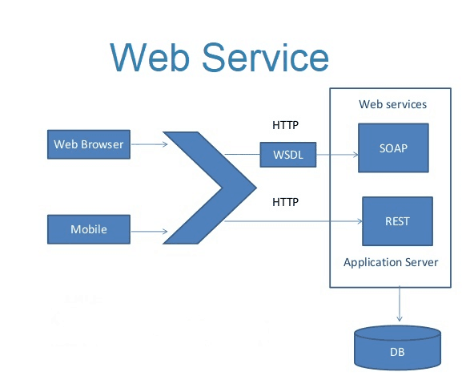
SOAP Services
SOAP is known as the Simple Object Access Protocol, a definition of how web services talk to each other or talk to client applications that invoke them.

Slide 15
Consuming a Web Service
Sign up for an account
Obtain an “API” key
Call the service endpoint and capture the response
Parse data values from stream

Slide 16
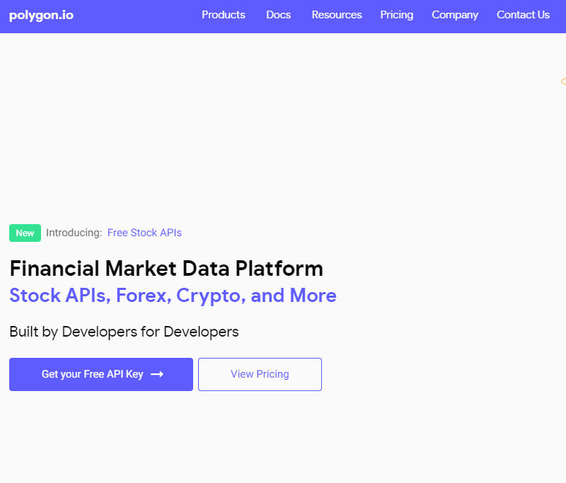
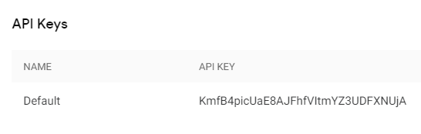
Example Commercial Stock API

Slide 17
“Mock” Stock Price Service
Commercial stock price services want to sell a subscription
They do not offer a “free” trial for evaluation
I have created a “Mock” service on a server I control using HTTP protocol
Issue HTTP request to server
Parse stock values from server’s JSON response

Slide 18
Stock Price Service Request
http://www.activitysuite.com/devry.aspx?api=stocks
https://jsonformatter.curiousconcept.com/

Slide 19
JSON Response
{
"dailyreport":[
{
"date":"11/12/2022",
"time":"23:01",
"stocks":[
{
"id":"1",
"symbol":"MSFT",
"name":"Microsoft",
"price":"212.60"
},
{
"id":"2",
"symbol":"GOOGL",
"name":"Alphabet Inc",
"price":"2851.00"
},
{
"id":"3",
"symbol":"FB",
"name":"Facebook Inc",
"price":"385.90"
}
]
}
}

Slide 20
Request Data from Service
import requests
from bs4 import BeautifulSoup
import matplotlib.pyplot as plt
import numpy as np
import json
import datetime as dt
# HTTP GET request to web service with "api" querystring parameter = "stocks"
page = requests.get("http://www.activitysuite.com/devry.aspx?api=stocks")
soup = BeautifulSoup(page.content, 'html.parser')
resp = soup.text

Slide 21
List Available Stocks
# Load daily reports into dictionary
# Print a list of the stocks from the first daily report
pydict = json.loads(resp)
print("Stocks in report:")
dailyreports = pydict["dailyreport"]
firstreport = dailyreports[0]
lastreport = dailyreports[len(dailyreports)-1]
for eachstock in firstreport["stocks"]:
print (eachstock["symbol"])

Slide 22
Extract Prices and Dates
#Extract the prices and dates for a selected stock
symbol = input("Enter Symbol: ").upper()
prices = []
dates = []
ticks = []
i = 0
for eachreport in pydict["dailyreport"]:
for eachstock in eachreport["stocks"]:
if eachstock["symbol"] == symbol:
oDate = dt.datetime.strptime(eachreport["date"], "%m/%d/%Y")
print(eachreport["date"] + " " + eachstock["symbol"] + " $" + eachstock["price"])
prices.append(float(eachstock["price"]))
dates.append(dt.datetime.strftime(oDate, "%m/%d"))
ticks.append(int(i))
i = i + 1

Slide 23
Plot the results
#Plot the results
price_array = np.array(prices)
price_min = np.min(price_array)
price_max = np.max(price_array)
plt.figure(figsize=(12,5), dpi=96)
plt.plot(dates, price_array, label="Stock Report for " + symbol)
plt.xticks(ticks, dates, rotation=45)
plt.ylim(0.95 * price_min, 1.05 * price_max)
plt.ylabel("P r i c e", fontsize=16)
plt.legend(loc="upper left")
plt.show()

